Slide 1
SENTIMENT ANALYSIS
MINI PROJECT 3
OCTOBER, 2021
BY
ANTHONY NNAMANI

Slide 2
QUESTION
BUSINESS QUESTION
How can we optimize our customer’s experience
DATA QUESTION
With the help of machine learning, can we predict whether our customers are satisfied with the Disney experience they get when they visit or not?

Slide 3



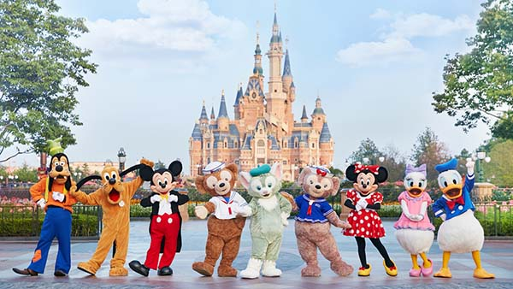
IMPORTANCE OF THIS STUDY
Disneyland parks host about 156m people in 2019
Reduced to about 43.5m people in 2020 (72% reduction)
Employs over 65,000 people
Disney California contribute $8.5b annually to the state economy
Lost about $21B in 2020 due to pandemic
Understanding their customers will go a long way in enhancing customer experience and maximize profit

Slide 4
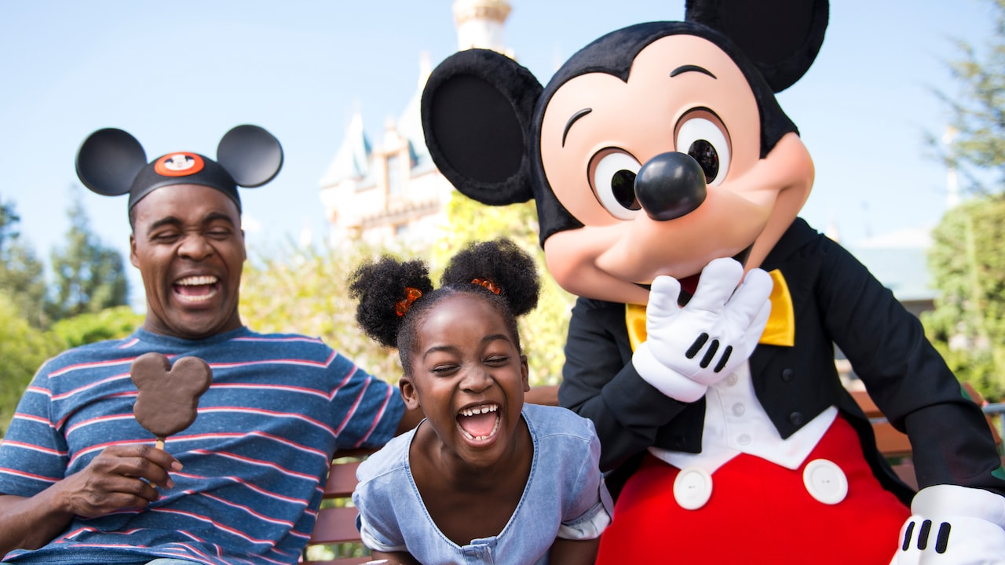
DATA OVERVIEW
Data is publicly available on Kaggle
It contains about 42,000 reviews post by Disney visitors on Trip Advisor website
The visitors were from three Disney branches; California, Hong Kong and Paris
It contains visitor’s review (Text) as well as rating (1 means very unsatisfied and 5 very satisfied)

Slide 5
PROJECT PIPLINE
Define
Data acquisition
Business questions
Strategy
Data Cleaning & EDA
Exploring data
Cleaning
Formatting
Visualization
Preprocessing
Normalization
Lemertization
Feature Engineering
Modelling
RandomForest
Logistic Regression
Naïve Bayes
Boosting
Further Steps
Apply Neural Network
Deployment

Slide 6
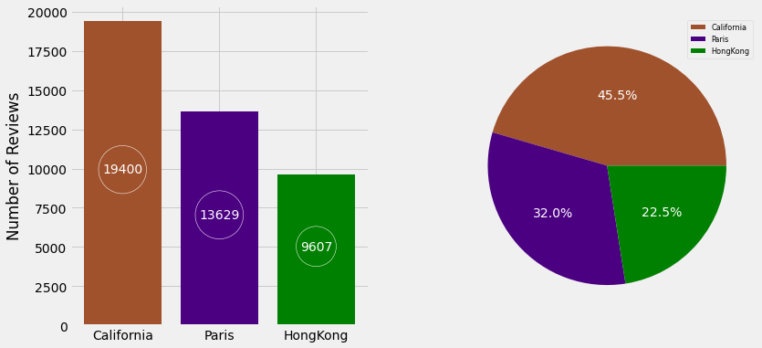
Number of Reviews by Disney Branch

Slide 7
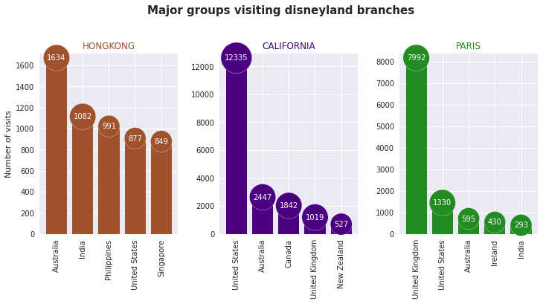
Top five countries that visit Disneyland
People tends to visit the Disney branch that is closer to them
Australians are among the top five groups visiting all the branches
Disney California is the most visited

Slide 8
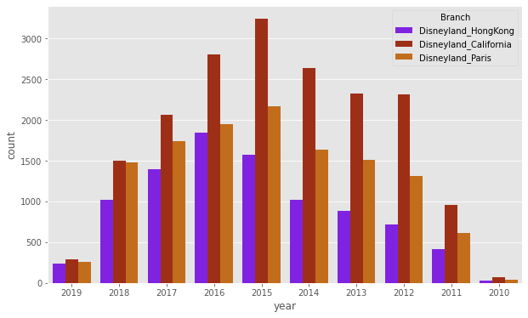
Disney visit over the years
It was increasing initially
The visitation to those branches peaked at about 2015 and then it started declining.
Disney California is the most visited

Slide 9
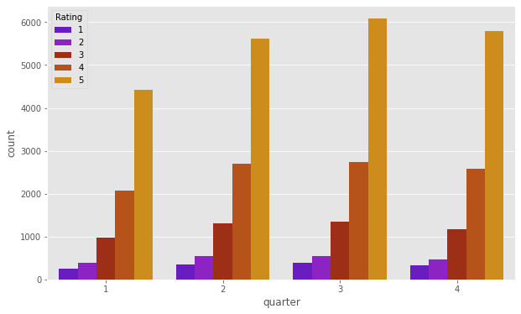
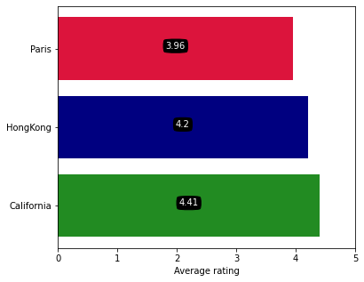
DISNEY RATING BY VISITORS
RATING BY QUARTER
AVERAGE RATING BY BRANCH

Slide 10
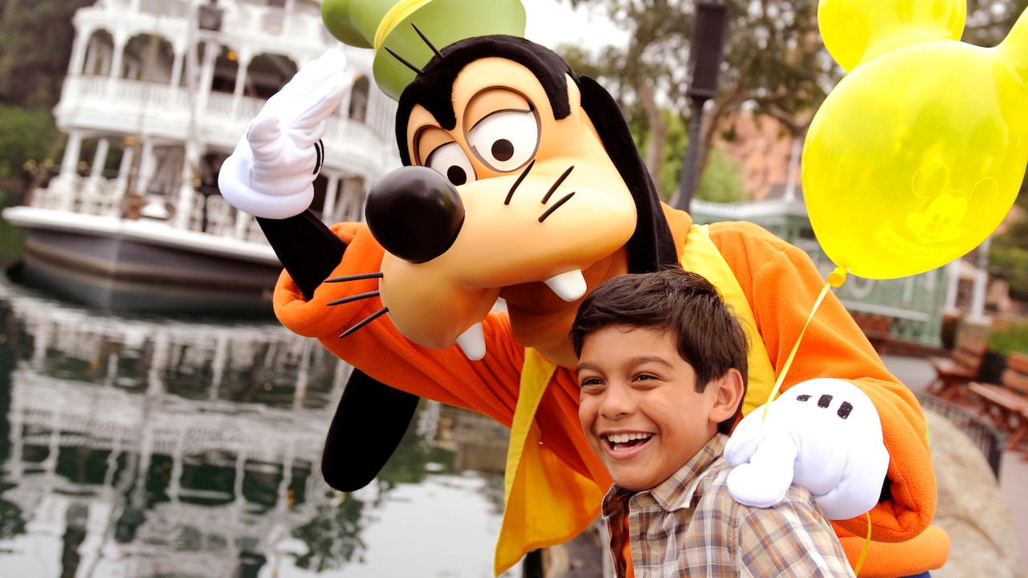
Pre-processing
Feature engineering with the following
CountVectorizer
Term Frequency - Inverse Document Frequency
NLTK
SentimentAnalyizer
Term Frequency - Inverse Document Frequency

Slide 11
MODEL RESULT
TF-IDF MODEL
 | ACCURACY | PRECISSION | RECALL | F1 SCORE
REGRESSION | 0.88 | 0.90 | 0.97 | 0.93
RANDOMFOREST | 0.82 | 0.82 | 1.0 | 0.90
NAÏVE BAYES | 0.80 | 0.80 | 1.0 | 0.89
ADABOOST | 0.785 | 0.86 | 0.87 | 0.87
N-GRAM MODELS
 | ACCURACY | PRECISION | RECALL | F1-SCORE
RANDOMFOREST | 0.799 | 0.80 | 1.00 | 0.93
REGRESSION | 0.88 | 0.90 | 0.96 | 0.89
NAIVE BAYES | 0.80 | 0.81 | 1.00 | 0.89
ADABOOSTING | 0.80 | 0.86 | 0.80 | 0.79

Slide 12
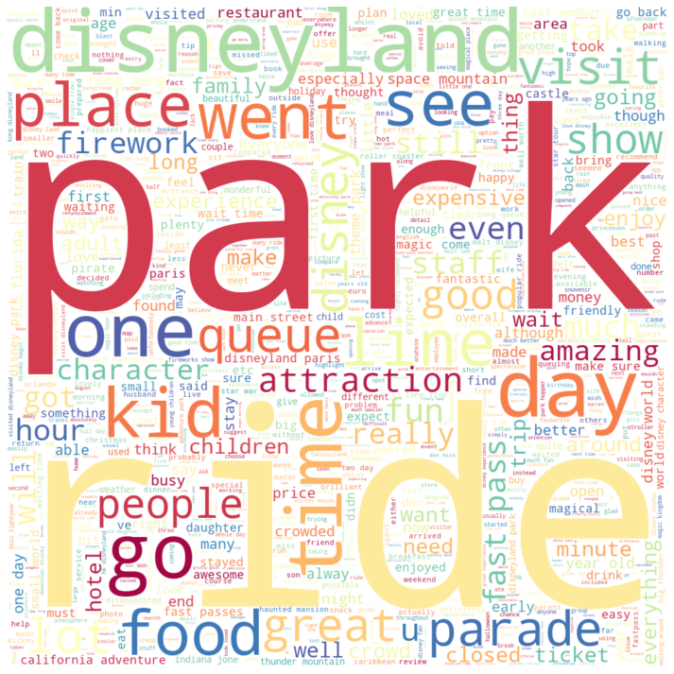
Most Occurring Positive Word

Slide 13
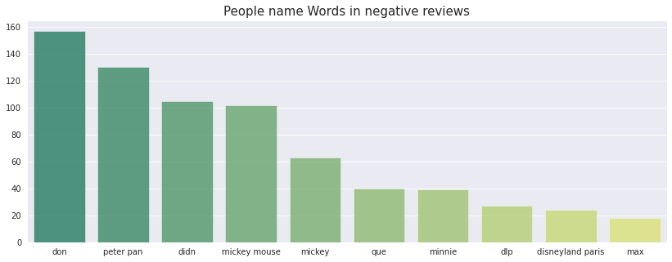
TEXT ANALYSIS
Most Occurring Name In The Negative Review
Customer Negative Review
“let me tell you that you CANNOT walk through the crowd to leave the park. It was so unsafe it was scary I had to bring out the New York in me and push him then yell for everyone to get the F out of the way so me and my kids can get through.”

Slide 14
SUMMARY AND RECOMENDATION
Analysing customers’ feedback is very vital in business
It gives the businesses an idea of how the customer want his/her needs to be met
Customers experience can be enhance if customers needs are clearly understood
Natural Language Processing is a vital tool through which those business objectives can be achieved
From my study, a lot of Disney visitors are happy with the service though some made their concern known
One of the concern was too many crowd at the park and during the Disney event
Disney coming up appropriate measure to reduce the crowd will be very helpful in optimizing their customer’s experience especially during this period of COVID

Slide 15
NEXT STEP
Applying more feature engineering
Will like to explore the data more with maybe Neural Network
Deploy the model if possible

Slide 16
THANK YOU
QUESTIONS

